Slide 1

Graphics and Graphical User Interfaces (GUIs)
CS 1181 – Computer Science II
Dr. Michael Raymer
Lecture materials adapted from:
ZyBooks ISBN: 979-8-203-16123-9 Dr. Cay Horstmann, Univ. of Michigan Dr. Roman Lysecky, Univ. of Arizona
Dr. Adrian Lizarraga, Univ. of Arizona
Dr. Travis Doom
Dr. Michelle Cheatham
Unless otherwise noted images are used under the creative commons license or used under license from Adobe Stock.

Slide 2
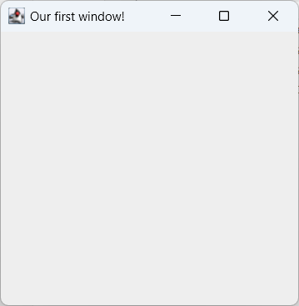
Creating a Window
public static void main(String args[]){
JFrame theWindow = new JFrame("Our first window!");
theWindow.setSize(300, 300);
theWindow.setLocation(200, 400);
theWindow.setDefaultCloseOperation(JFrame.EXIT_ON_CLOSE);
theWindow.setVisible(true);
}
Icon
Control
buttons
Title
Content Pane
(usually a JPanel or a subclass of JPanel)

Slide 3
Our First Execution Thread
Why is the program still running when main() is done??
public static void main(String args[]){
JFrame theWindow = new JFrame("Our first window!");
theWindow.setSize(300, 300);
theWindow.setLocation(200, 400);
theWindow.setDefaultCloseOperation(JFrame.EXIT_ON_CLOSE);
theWindow.setVisible(true);
System.out.println("Done!");
}
The Event Dispatch Thread (EDT) waits for clicks, drags, re-sizes, keyclicks, and other events and responds to them.

Slide 4

Our First Execution Thread
public static void main(String args[]){
int clicks = 0;
JFrame theWindow = new JFrame("Our first window!");
theWindow.setSize(300, 300);
theWindow.setLocation(200, 400);
theWindow.setDefaultCloseOperation(JFrame.EXIT_ON_CLOSE);
theWindow.setVisible(true);
System.out.println("Done!");
}
while (window-open){
if (button-clicked){
do something;
}
else if (window-resized){
do something;
}
else if …
}

Slide 5
Keeping track of data
If main() is going to exit, where do we keep all our variables and data?
There are several approaches, but we’ll usually create a subclass of JFrame and use instance variables for all our persistent data. This data will live for as long as our main application window is not closed.

Slide 6
Keeping track of data
Data I want to keep around until the main window is closed.
class MainWindow extends JFrame{
private int clickCount;
public MainWindow(String title){
super(title);
clickCount = 0;
}
public static void main(String args[]){
JFrame theWindow = new MainWindow("Our first window!");
theWindow.setSize(300, 300);
theWindow.setLocation(200, 400);
theWindow.setDefaultCloseOperation(JFrame.EXIT_ON_CLOSE);
theWindow.setVisible(true);
System.out.println("Done!");
}
}
This is where inheritance gets really useful!

Slide 7
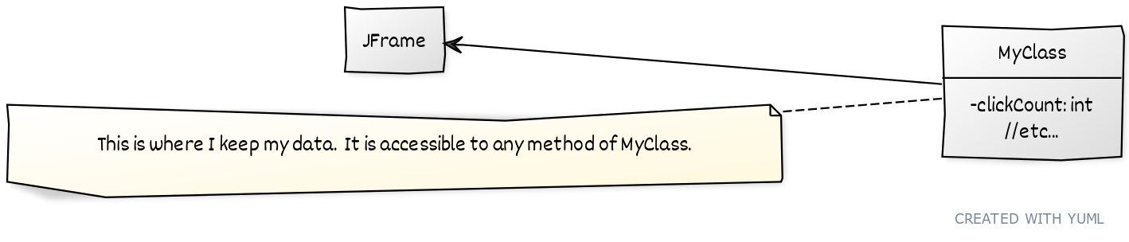
Keeping track of data
class MainWindow extends JFrame{
private int clickCount;
public MainWindow(String title){
super(title);
clickCount = 0;
}
public static void main(String args[]){
JFrame theWindow = new MainWindow("Our first window!");
theWindow.setSize(300, 300);
theWindow.setLocation(200, 400);
theWindow.setDefaultCloseOperation(JFrame.EXIT_ON_CLOSE);
theWindow.setVisible(true);
System.out.println("Done!");
}
}

Slide 8
Adding GUI Elements
Java’s built-in GUI library, called Swing, has all kinds of useful GUI elements: buttons, sliders, scrollbars, labels, and more.
Example: A clickable button
public MainWindow(String title){
super(title);
clickCount = 0;
JButton aButton = new JButton("Click me!");
this.add(aButton);
}

Slide 9

Adding GUI Elements
I’m lying, but we’ll get to that later.
BUT… a JFrame only shows one item:
public MainWindow(String title){
super(title);
clickCount = 0;
JButton aButton = new JButton("Click me!");
this.add(aButton);
JButton otherButton = new JButton("Click me too!");
this.add(otherButton);
}
So, what do we do about that?

Slide 10
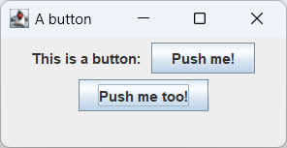
JPanel (and Layout Managers) to the Rescue!
JPanel can hold all kinds of GUI elements and allows you to set a Layout Manager to keep them nicely arranged.

Slide 11
JPanel (and Layout Managers) to the Rescue!
The default layout manager is called FlowLayout. We’ll see some others soon.
public MainWindow(String title){
super(title);
clickCount = 0;
JPanel content = new JPanel();
this.setContentPane(content);
JButton aButton = new JButton("Click me!");
content.add(aButton);
JButton otherButton = new JButton("Click me too!");
content.add(otherButton);
}

Slide 12
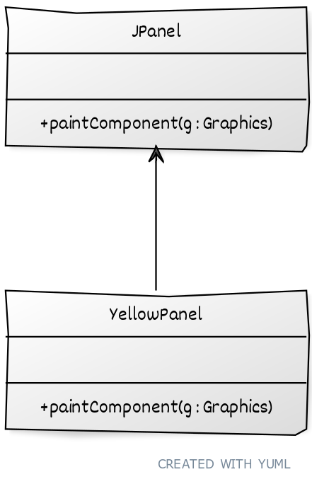
A side experiment
Let’s use inheritance to see where our JPanel lives.
Java calls void paintComponent(Graphics g) when a GUI component needs to be re-drawn
Think of a Graphics object like a pen, it can be used to change colors and draw things like lines and shapes.
Notes:
A better choice is to use content.setBackground(Color.YELLOW);

Slide 13
Listening for Events
Wouldn’t it be nice if our buttons did more than just look like buttons?
listener1
<<ActionListener>>
ButtonListener
+actionPerformed(actionEvent e)
listener2
<<ActionListener>>
ButtonListener
+actionPerformed(actionEvent e)
ButtonListener listener1 = new ButtonListener();
aButton.addActionListener(listener1);

Slide 14
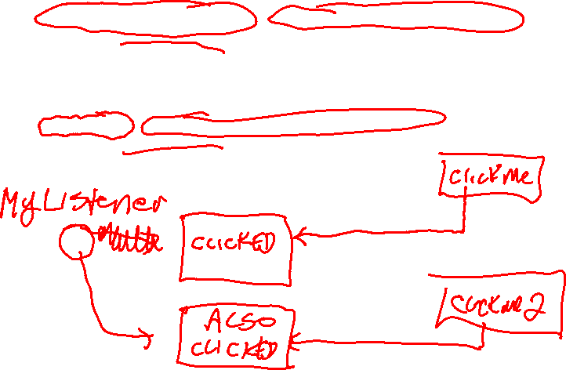
JButton button = new JButton("Click me");
content.add(button);
ButtonListener myListener = new ButtonListener("CLICKED");
button.addActionListener(myListener);
JButton button2 = new JButton("Click me 2");
content.add(button2);
myListener = new ButtonListener("ALSO CLICKED")
button2.addActionListener(myListener);

Slide 15
Listening for Events
The ActionListener interface has just one method: actionPerformed
public class ButtonListener implements ActionListener{
@Override
public void actionPerformed(ActionEvent e){
System.out.println("The button was pressed!");
}
}
ActionEvents hold information about the event
@Override prevents errors caused by typos

Slide 16
Why won’t this work?
public static void main(String args[]){
JFrame theWindow = new MainWindow("Our first window!");
theWindow.setSize(300, 300);
theWindow.setLocation(200, 400);
theWindow.setDefaultCloseOperation(JFrame.EXIT_ON_CLOSE);
JPanel content = new JPanel();
theWindow.setContentPane(content);
int clickCount = 0;
JButton aButton = new JButton("Click me!");
ButtonListener listener1 = new ButtonListener();
aButton.addActionListener(listener1);
content.add(aButton);
theWindow.setVisible(true);
}
public class ButtonListener implements ActionListener{
@Override
public void actionPerformed(ActionEvent e){
clickCount++;
System.out.println("The button has been clicked " + clickCount + " times");
}
}

Slide 17
Ok, what about this?
class MainWindow extends JFrame{
private int clickCount;
public MainWindow(String title){
super(title);
JPanel content = new JPanel();
this.setContentPane(content);
clickCount = 0;
JButton aButton = new JButton("Click me!");
ButtonListener listener1 = new ButtonListener();
aButton.addActionListener(listener1);
content.add(aButton);
}
public class ButtonListener implements ActionListener{
@Override
public void actionPerformed(ActionEvent e){
clickCount++;
System.out.println("The button has been clicked " + clickCount + " times");
}
}

Slide 18
Inner Classes
We need a way to access clickCount from actionPerformed!
If we create the class ButtonListener inside the class MainWindow, it can access every field of MainWindow, even private ones.
This is called an Inner Class in Java.

Slide 19
Using an Inner Class
class MainWindow extends JFrame {
private int clickCount;
public MainWindow(String title) {
super(title);
clickCount = 0;
JPanel content = new JPanel();
this.setContentPane(content);
// This Inner Class can see all of MainWindow’s private variables:
class ButtonListener implements ActionListener {
@Override
public void actionPerformed(ActionEvent e) {
clickCount++;
System.out.println("The button has been clicked " + clickCount + " times");
}
}
JButton aButton = new JButton("Click me!");
aButton.addActionListener(new ButtonListener());
content.add(aButton);
}

Slide 20
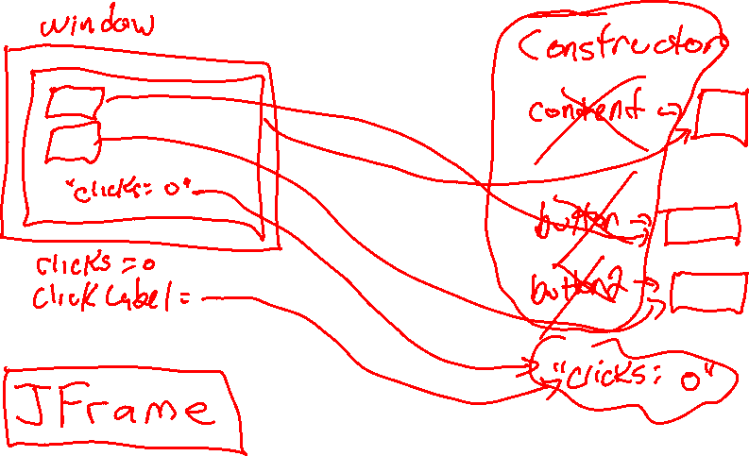

Slide 21
Anonymous Inner Classes
If we aren’t going to re-use the class, we can create it inside the call to addActionListener()
JButton aButton = new JButton("Click me!");
aButton.addActionListener(new ActionListener(){
@Override
public void actionPerformed(ActionEvent e) {
clickCount++;
System.out.println("The button has been clicked "
+ clickCount + " times");
}});
content.add(aButton);

Slide 22


Anonymous Inner Classes
aButton.addActionListener(new ActionListener(){ code });
Anonymous object
ActionListener
public void actionPerformed(ActionEvent e) {
clickCount++;
System.out.println(
"The button has been clicked "
+ clickCount + " times");
}

Slide 23
Lambda Expressions
Can we make this even more concise?
JButton aButton = new JButton("Click me!");
aButton.addActionListener(e -> {
clickCount++;
System.out.println("The button has been clicked "
+ clickCount + " times");
});

Slide 24

How does Java know??
Hmm… addActionListener expects one parameter, an ActionListener, so I guess I need to create an ActionListener reference variable.
ActionListener
aButton.addActionListener(e -> {code});
Image source: https://www.oracle.com/il-en/java/duke/

Slide 25

How does Java know??
What kind of object should I point it to? I guess an anonymous one, but an ActionListener must have actionPerformed(ActionEvent e), so I guess that’s where the code goes.
ActionListener
Anonymous object
aButton.addActionListener(e -> {code});
Image source: https://www.oracle.com/il-en/java/duke/

Slide 26


How does Java know??
Anonymous object
ActionListener
public void actionPerformed(ActionEvent e) {
code
}
aButton.addActionListener(e -> {code});

Slide 27



One ActionListener or many?
public void
actionPerformed
(ActionEvent e) {
…
}
public void
actionPerformed
(ActionEvent e) {
…
}
public void
actionPerformed
(ActionEvent e) {
…
}
public void
actionPerformed
(ActionEvent e) {
…
}
if (e.getSource() == aButton){
...
}
public void
actionPerformed
(ActionEvent e) {
…
}

Slide 28
ActionListeners and the EDT
ActionListener code runs in the EDT, which means it is dangerous to perform long calculations. Your program will lag, and user events will pile up.
countButton.addActionListener(e -> {
for (int i = 1; i <= 10; i++){
System.out.println("Counting: " + i);
try {
Thread.sleep(1000);
} catch (InterruptedException ex) {
ex.printStackTrace();
}
}
});

Slide 29
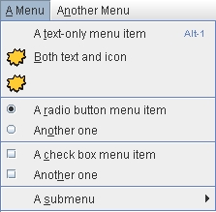
GUI Elements in Swing
JLabel
JCheckBox
JRadioButton and ButtonGroup
JList
JMenuBar, Jmenu, and JMenuItem
JComboBox
JSlider, JScrollBar
Image source: https://web.mit.edu/6.005/www/sp14/psets/ps4/java-6-tutorial/components.html

Slide 30
BorderLayout
BorderLayout.NORTH
WEST
BorderLayout.CENTER
EAST
BorderLayout.SOUTH

Slide 31

BoxLayout
content.setLayout(new BoxLayout(content, BoxLayout.X_AXIS));
content.setLayout(new BoxLayout(
content, BoxLayout.Y_AXIS));

Slide 32
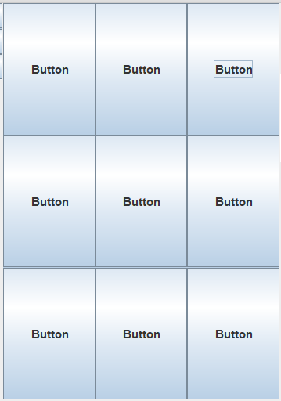
GridLayout
content.setLayout(new GridLayout(3, 3));

Slide 33
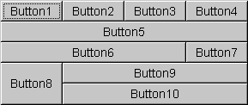
GridBagLayout
Dynamic Grid – created as you add elements
Set Sizes and insets (padding) as you go
You can span rows and columns
Complex, but powerful
See examples in ZyBooks
https://docs.oracle.com/javase/8/docs/api/java/awt/GridBagLayout.html

Slide 34
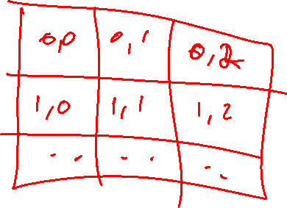

Slide 35
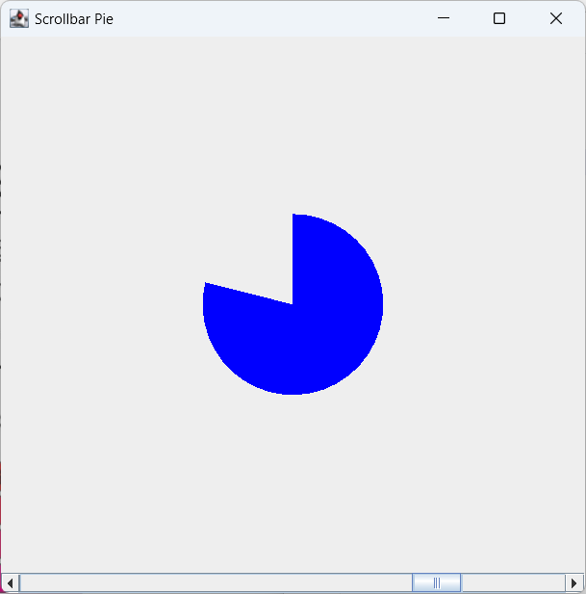
Drawing your own objects
JComponent is the parent (or grandparent) class for most Swing GUI components
Override paintComponent() to draw graphics
public class Drawing extends JComponent{
// When we re-paint this JComponent, draw a few simple shapes:
@Override
public void paintComponent(Graphics g){
g.setColor(Color.BLACK);
g.drawOval(50, 50, 75, 75);
g.drawRect(this.getWidth()/2, this.getHeight()/2, 50, 50);
}
}

Slide 36
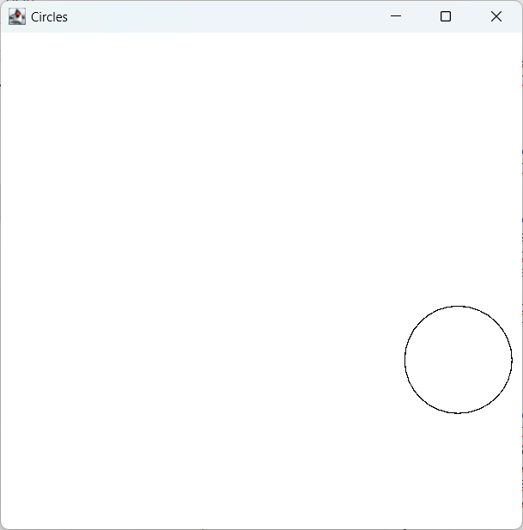
Animation
Animation can be done using the main() thread, using timers, or by creating new threads, which we will discuss later.

